Slide 1
IPL AUCTION STRATERGY
BY
MIDHUN BALACHANDRAN PV
15 SEPTEMBER 2023
PGC DATA SCIENCE

Slide 2
Task-1 (aggressive batsmen) - query
create table ipl_batsman as select batsman,
count (ball) as balls_faced, sum (batsman_runs) as runs_scored
from ipl_ball group by batsman;
alter table ipl_batsman add column strike_rate numeric;
alter table ipl_batsman alter column balls_faced type numeric;
alter table ipl_batsman alter column runs_scored type numeric;
update ipl_batsman set strike_rate = (runs_scored/balls_faced)*100;
select * from ipl_batsman
where balls_faced>=500
order by strike_rate desc limit 10;

Slide 3
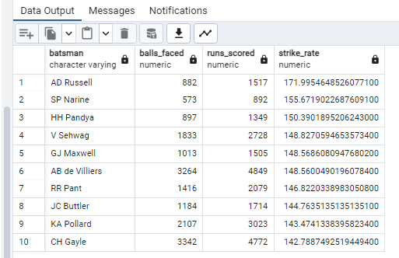

Slide 5
Task 2 (anchor batsman) - query
create table Batting_avg_data as
(select batsman, sum (batsman_runs) as total_runs,
count (distinct id) as matches_played,
sum (is_wicket) as no_of_dismissal from ipl_ball
group by batsman having count (distinct id)>=28);
alter table batting_avg_data alter column total_runs type numeric,
alter column no_of_dismissal type numeric;
alter table batting_avg_data add column batting_avg numeric;
update batting_avg_data set batting_avg = (total_runs/no_of_dismissal);
select * from batting_avg_data order by batting_avg desc limit 10;

Slide 6
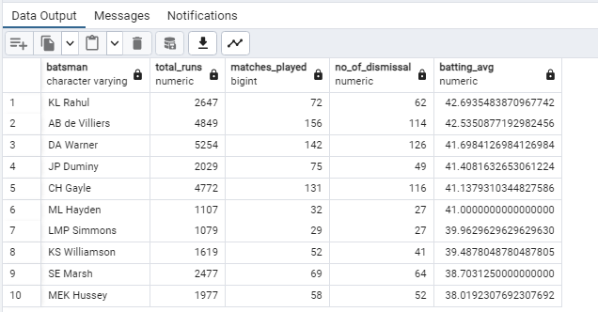
Data output

Slide 8
Task 3 (hard hitters) - query
create table hard_hitters as (select batsman, sum(case when
batsman_runs=4 or batsman_runs=6 then batsman_runs else 0 end)
as runs_in_boundaries, sum (batsman_runs) as total_runs,
count(distinct id) as no_of_matches
from ipl_ball group by batsman having count(distinct id)>=28
order by runs_in_boundaries desc);
alter table hard_hitters add column boundary_percentage numeric,
alter column runs_in_boundaries type numeric,
alter column total_runs type numeric;
update hard_hitters
set boundary_percentage=(runs_in_boundaries/total_runs)*100;
select * from hard_hitters order by boundary_percentage desc limit 10;

Slide 9
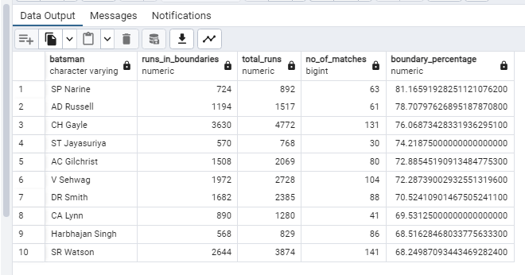
Data output

Slide 11
Task 4 (economy bowlers) - query
create table eco_bowler
as (select bowler, sum (total_runs) as runs_conceded, round (count(ball)/6) as over_bowled, count(ball) as no_of_balls from ipl_ball group by bowler having count(ball)>=500);
alter table eco_bowler alter column over_bowled type numeric,
alter column runs_conceded type numeric, add column eco_rate numeric;
update eco_bowler set eco_rate = (runs_conceded/over_bowled);
select * from eco_bowler order by eco_rate asc limit 10;

Slide 12
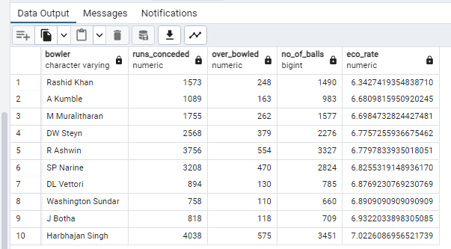

Slide 14
Task 5 (bowler with best strike rate) - query
select bowler, count(ball) as no_of_balls, sum(is_wicket) as wickets,
count(ball)/sum(is_wicket) as strike_rate
from ipl_ball group by bowler
having count(ball)>=500 order by strike_rate asc limit 10;

Slide 15


Slide 17
Task 6 ( all rounders) - query
create table ipl_bowler as
( select bowler, count (ball) as no_of_balls, sum (is_wicket) as wickets,
count (ball) / sum (is_wicket) as strike_rate
from ipl_ball group by bowler
having count(ball)>=300 order by strike_rate asc );
create table ipl_batsman_1 as(select * from ipl_batsman
where balls_faced>=500 order by strike_rate desc);
alter table ipl_bowler rename strike_rate to bowler_strike_rate;
alter table ipl_batsman_1 rename strike_rate to batsman_strike_rate;
create table all_rounder as (select * from ipl_bowler inner join ipl_batsman_1
on ipl_bowler.bowler = ipl_batsman_1.batsman);
select batsman as player, bowler_strike_rate, batsman_strike_rate
from all_rounder limit 10;

Slide 18
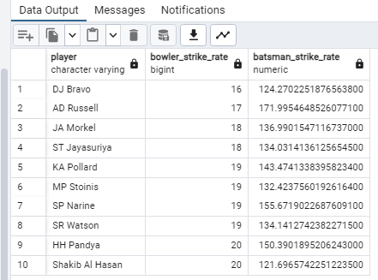
Data output

Slide 20
Task 7 (wicket keepers)
select fielder, count(dismissal_kind) as no_of_catches
from ipl_ball group by fielder, dismissal_kind having dismissal_kind='caught‘
order by no_of_catches desc LIMIT 10;
CRITERIA FOR WICKET KEEPER SELECTION ; The primary criterion is the ability to keep wickets efficiently, including catching, stumping, and general agility behind the stumps.
NOTE : THE QUERY GIVEN ABOVE WILL GIVE US THE TOP FIELDERS WHO HAVE DONE MORE NO OF CATCHES WHICH MEANS THOSE PLAYERS WILL BE AN EXPERIENCED FIELDERS WHO IS MOST PROBABLY A GOOD FIT FOR WICKET KEEPERS THE LIST OF PLAYERS WILL BE ON UPCOMING SLIDE.
OTHER SELECTION CRITERIAS : a wicketkeeper who can contribute runs with the bat adds significant value to the team's overall performance.
A wicketkeeper needs to maintain constant communication with the bowlers and other fielders, offering guidance and support.
Experience in high-pressure situations and the confidence to handle them effectively

Slide 21
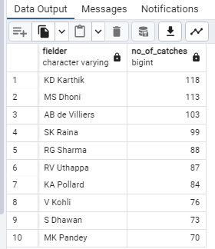
DATA OUTPUT

Slide 23
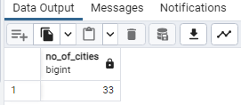
Additional questions
No 1) query - select count (distinct city) as no_of_cities from ipl_matches ;

Slide 24
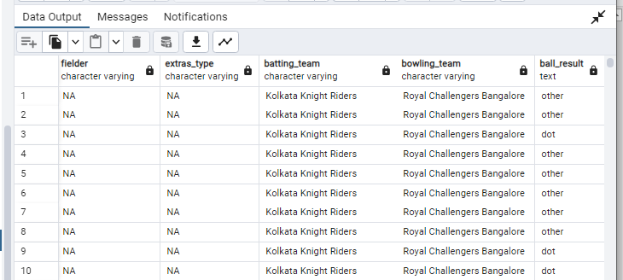
Additional questions
No 2 ) query - create table deliveries_v02
as (select *, case when total_runs>=4 then 'boundary'
when total_runs=0 then 'dot' else 'other'end as ball_result from ipl_ball);
select * from deliveries_v02 ;

Slide 25
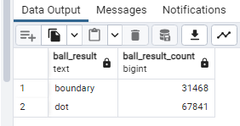
Additional questions
No 3 ) query - select ball_result, count (ball_result) as ball_result_count
from deliveries_v02 where ball_result in ('boundary‘ , 'dot')
group by ball_result;

Slide 26
Additional questions
No 4 ) query - select batting_team, count (ball_result) as no_of_boundaries
from deliveries_v02 where ball_result = 'boundary'
group by batting_team order by no_of_boundaries desc ;

Slide 27
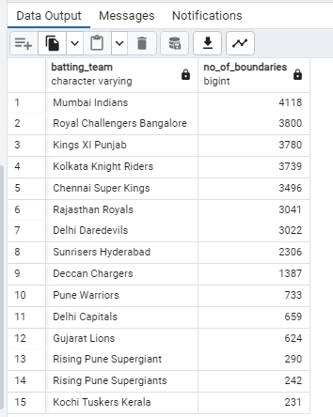

Slide 28
Additional questions
No 5 ) query – select bowling_team, count (ball_result) as no_of_dots
from deliveries_v02 where ball_result = 'dot'
group by bowling_team order by no_of_dots desc;

Slide 29


Slide 30
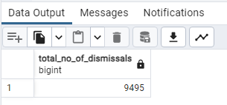
Additional questions
No 6 ) query - select count (dismissal_kind) as total_no_of_dismissals
from deliveries_v02 where dismissal_kind not in ( ‘NA‘ ) ;

Slide 31
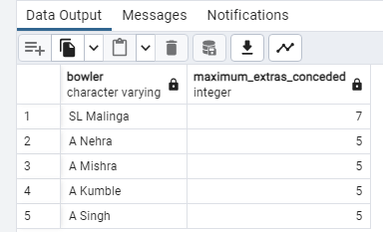
Additional questions
No 7 ) query - select bowler, max (extra_runs) as maximum_extras_conceded
from ipl_ball group by bowler
order by maximum_extras_conceded desc limit 5 ;
Important note : from question number 7 it was not clear that whether
we need to find the bowlers who gave highesr extra runs so far or bowlers who gave maximum extras
in a single delivery since it is written maximum iam assuming the later case if we want to find bowler
with highest extras so far just replace ‘max’ function with ‘sum’ function…

Slide 32
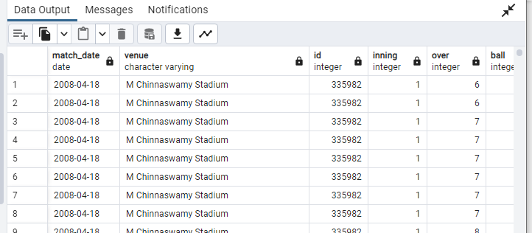
Additional questions
No 8) query - create table deliveries_v03 as (select ipl_matches.date as match_date,
ipl_matches.venue, deliveries_v02.* from ipl_matches
left join deliveries_v02
on ipl_matches.id = deliveries_v02 .id) ;
select * from deliveries_v03 ;

Slide 33
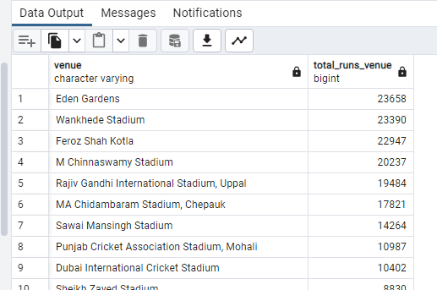
Additional questions
No 9) query - select venue, sum (total_runs) as total_runs_venue from deliveries_v03
group by venue order by total_runs_venue desc ;

Slide 34
Additional questions
No 10) query - select venue, extract (year from match_date ) as match_year,
sum (total_runs) as yearly_total_runs from deliveries_v03
where venue = 'Eden Gardens‘ group by match_year,venue
order by yearly_total_runs desc ;

Slide 35
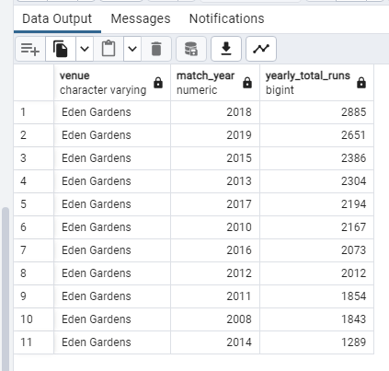

Slide 36
Thank you

